Slide 1
Unit 2. Class Implementation
封装性
2.1 Implementing Classes
2.2 Inheritance
2.3 Polymorphism
2.4 Generic type
2.5 Collections
2.6 Abstract class
2.7 Interface
继承性
多态性
一对多关联关系的实现
基类的重新考虑
马春燕
西北工业大学软件学院

Slide 2
2.3 Polymorphism
The term polymorphism is defined in Merriam-Webster’s dictionary as “the quality or state of being able to assume different forms.”
In an Object-Oriented Programming Language, polymorphism is One Distinguishing Feature.
    Polymorphic variable
    Polymorphic method call
    Discussion
马春燕
西北工业大学软件学院

Slide 3
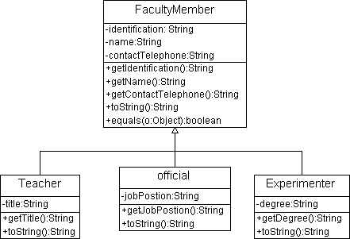
2.3 Polymorphism
2. Polymorphic method call
FacultyMemeber m;
m.toString ();
Polymorphic variable
Polymorphic method call
马春燕
西北工业大学软件学院

Slide 4
2. Polymorphic method call (cont)
The line of code m.toString( ) said to be polymorphic because the logic performed in response to the same method call can take many different forms, depending on the class identity of the object at run time.
马春燕
西北工业大学软件学院

Slide 5
2. Polymorphic method call (cont)
How Polymorphism Works Behind the Scenes (Static vs. Dynamic Binding)
  Static Binding----compile-time
    FacultyMember m；
  Dynamic Binding---run-time
    Java Virtual Machine (JVM) determines which version of the method to execute by examining the reference variable (polymorphic variable) used in the method call.
马春燕
西北工业大学软件学院

Slide 6
3. Discussion
Polymorphic variable allows
  many types (derived from the same base type) to be treated as if they were one type, and a single piece of code to work on all those different types equally.
polymorphic method call allows
  one type to express its distinction from another, similar type, as long as they’re both derived from the same base type.
For example FacultyDemo.java
马春燕
西北工业大学软件学院

Slide 7
2.3 Polymorphism
3. Discussion (cont.)
Class diagram designing
  The design solution of Software College Management System (SCMS )
      One class Associates with all subclasses of some base class-------> One class Associates with the base class
马春燕
西北工业大学软件学院

Slide 8
3. Discussion (cont.)
Polymorphism Simplifies Code Maintenance
  Polymorphism can make our code much more concise.
    If the programming language doesn’t support polymorphism
      We have to do with a variety of different kinds of faculty members using a series of if tests.
      For example
马春燕
西北工业大学软件学院

Slide 9
3. Discussion (cont.)
Polymorphism Simplifies Code Maintenance
  Better still, polymorphic client code is robust to change.
    For example, long after our SCMS application has been coded, tested, and deployed, we derive classes called Administrator and DeanOfficial from official, each of which in turn overrides the printInfo method of official to provide its own “flavor” of print functionality. We’re now free to randomly insert Administrators and DeanOfficials into our Faculty collection, our polymorphic code for iterating through the collection doesn’t have to change!
马春燕
西北工业大学软件学院

Slide 10
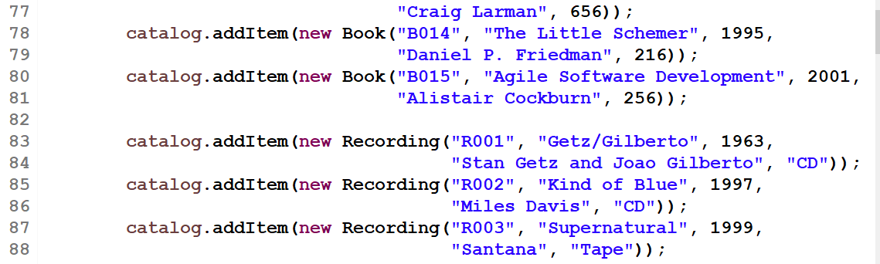
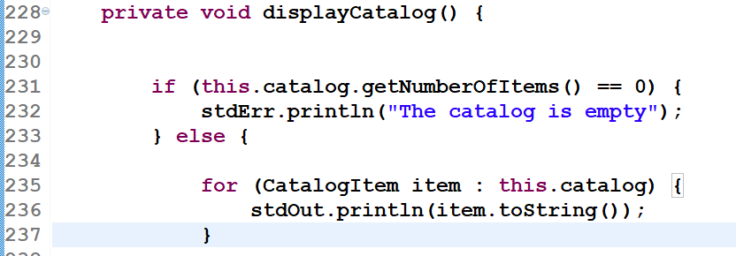
图书馆系统中的多态
Polymorphic variable
Polymorphic method call
马春燕
西北工业大学软件学院

